Slide 1

Movie Recommender
Under The Guidance Of:
Mr. Ritviz Singh
Mr. Shiv Patel
Team:
Abhishek Bhosale
Prajwal Dhagude
Pranit Awale
Abhishek Sahani
Supriya Dhage

Slide 2
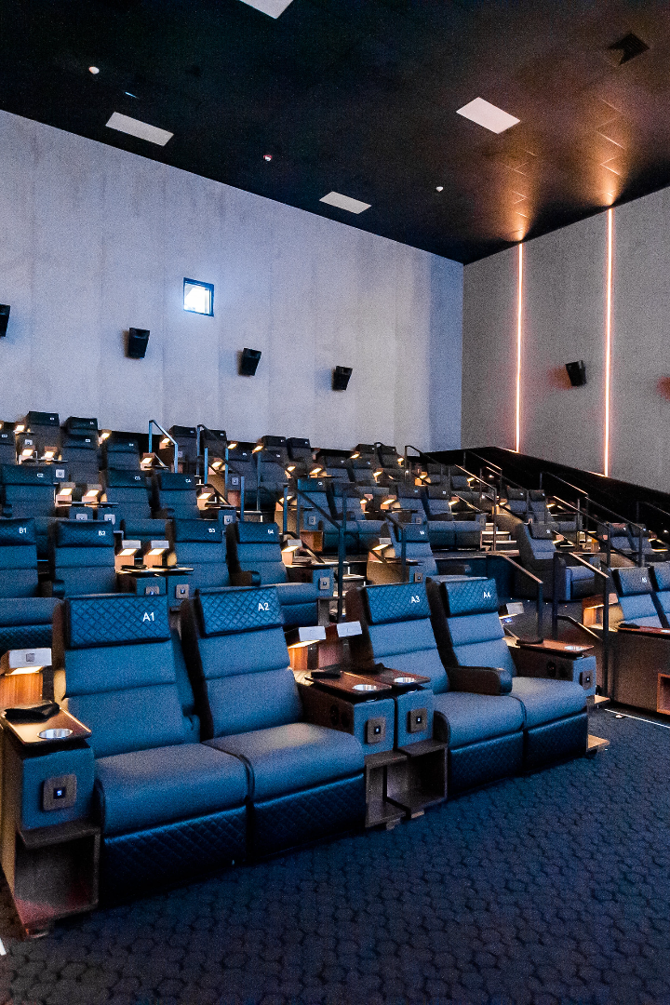
Movie Recommender System with NLTK and Scikit-learn
A brief overview of the movie recommender system project, which involved cleaning and pre-processing the TMDB movies data set. Various libraries were used to create a machine learning-based recommendation system.

Slide 3

Dataset Description: TMDB Movies
1
Overview
2
Features
The Movies Dataset consists of metadata for over 5000 movies.
Dataset includes data on budget, revenue, cast, and crew, plus column-specific information like genres, release date, and more.
3
Data Cleaning
To clean the dataset, we removed incomplete columns, handled missing values and duplicates and filtered out unwanted data that could impact recommendations.

Slide 4

Libraries Used in the Project
1
NLTK
2
Scikit-learn
We used NLTK to tokenize and stem movie plot descriptions and train a cosine similarity model to make movie recommendations.
Scikit-learn was used to preprocess the data, convert text data to numerical data using CountVectorizer and normalize feature vectors. We also used Scikit-learn to train the machine learning model.
3
NumPy and Pandas
We used NumPy and Pandas for data manipulation and cleaning, and to extract features from the movie data set.

Slide 5
Machine Learning Model
1
Stemming
We stemmed movie plot descriptions to extract important features from the text. Stem Porter was used.
2
Feature Extraction
We extracted features using CountVectorizer to convert movie plots into a sparse matrix of token counts.
3
Training the Model
We used cosine_similarity to train a model on the movie data set, with a focus on supervised learning using a pairwise classifier.
4
Performance Evaluation
We used CountVectorizer and cosine_similarity to evaluate the performance of the model and fine-tune the ranking, making sure that the recommendations are accurate, diverse and unique.

Slide 6
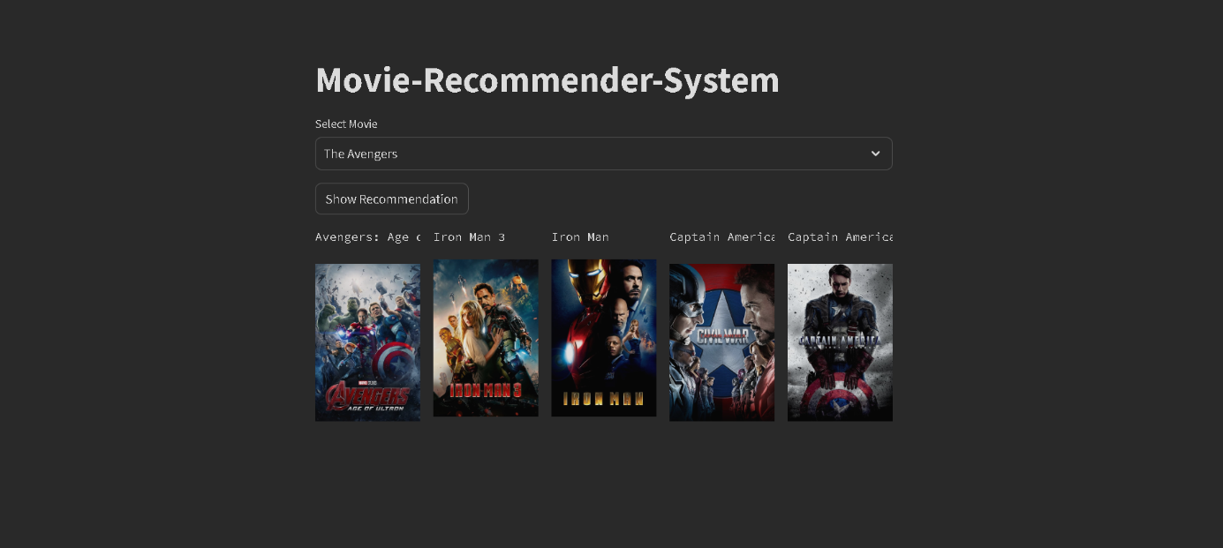
Screenshot:

Slide 7
Conclusion
An overall successful project
Limitations and areas for improvement
Future work
Looking ahead, we could explore other natural language processing techniques, hybrid models that incorporate both content and collaborative information, and different approaches to feature extraction and dimensionality reduction for our data set.
Despite the complexity of the dataset and multiple challenges along the way, we were able to create a working recommendation system thanks to careful data cleaning and processing, advanced machine learning techniques, and the right libraries.
Further improvements could be made in terms of item and feature representation, model complexity and accuracy, and the addition of metadata that could help make even more accurate recommendations.

Slide 8



Acknowledgements
Python
NLTK
Scikit-learn
We're grateful to Python for providing a dynamic, high-level programming language that made this project possible.
We're grateful to NLTK for providing fundamental tools for building natural language processing programs, including stemming.
We're grateful to Scikit-learn for providing essential machine learning libraries that allow for input data and evaluation of output performance.

Slide 9
THANK YOU

